Slide 1
2023 UMANT Strategic Planning Retreat
City of Irving City Hall
January 13, 2023

Slide 2
Agenda
1. Year in Review
2 Upcoming 2023 Introductions & Expectations
3. Committee Breakout
4. Calendar Discussion
5. Other Items
-Communications
-Membership & Partnership
-Networking & Mentorship
-Special Events
-Professional Development

Slide 3

Last year

Slide 4
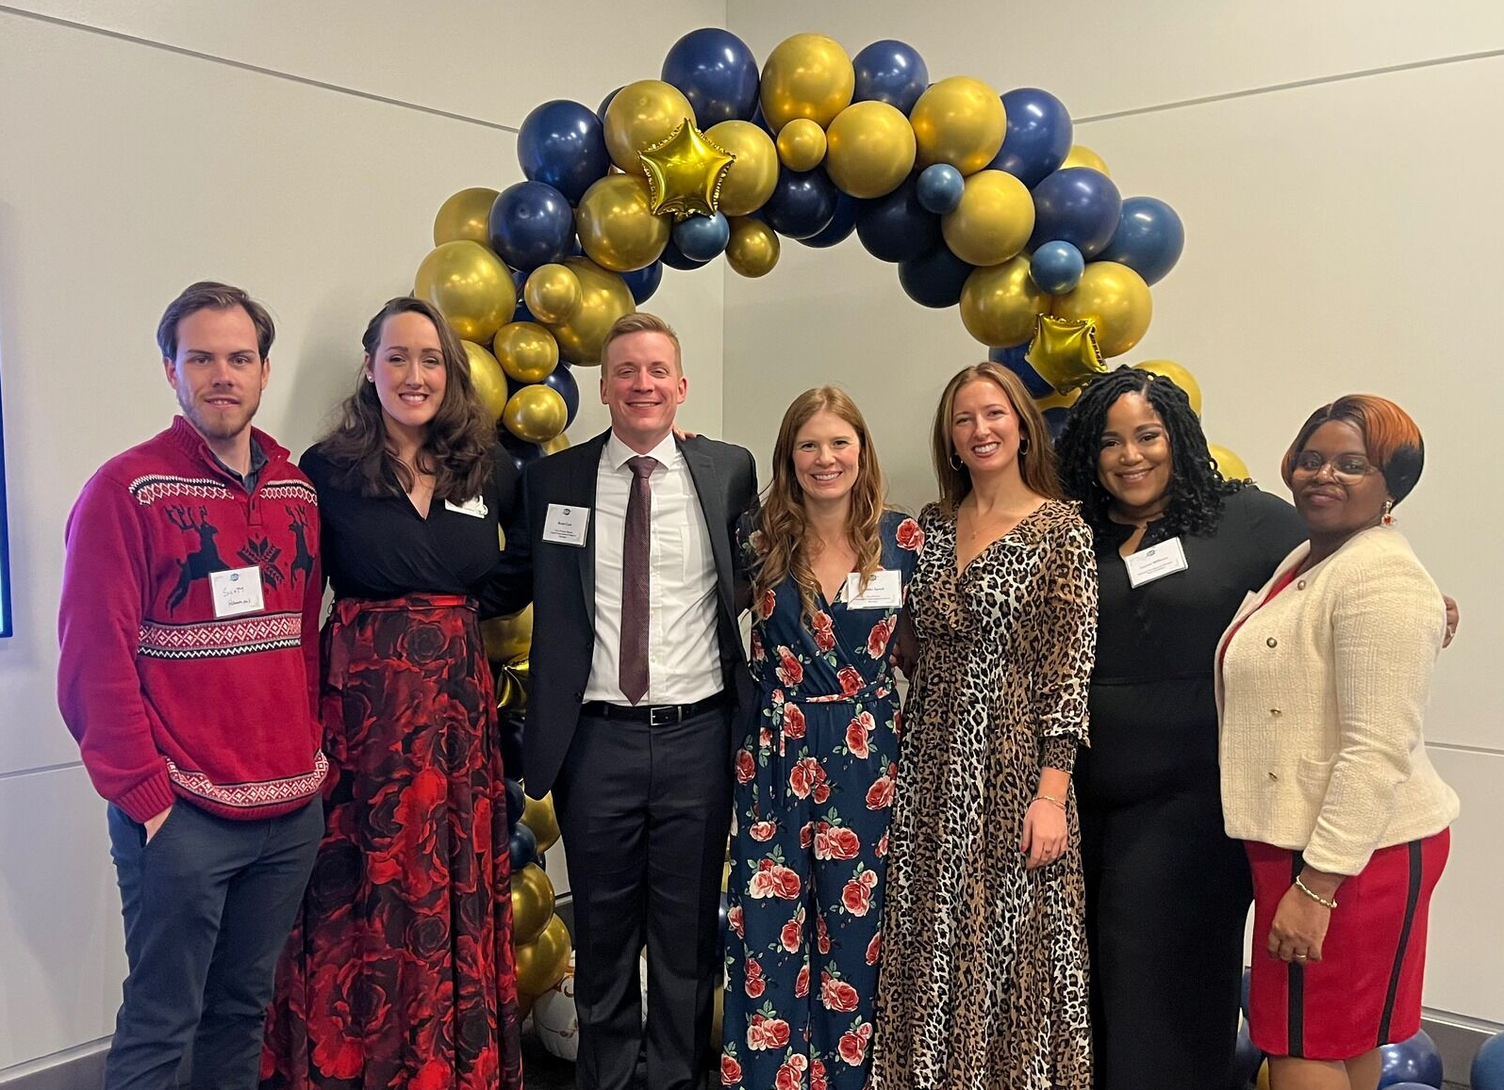



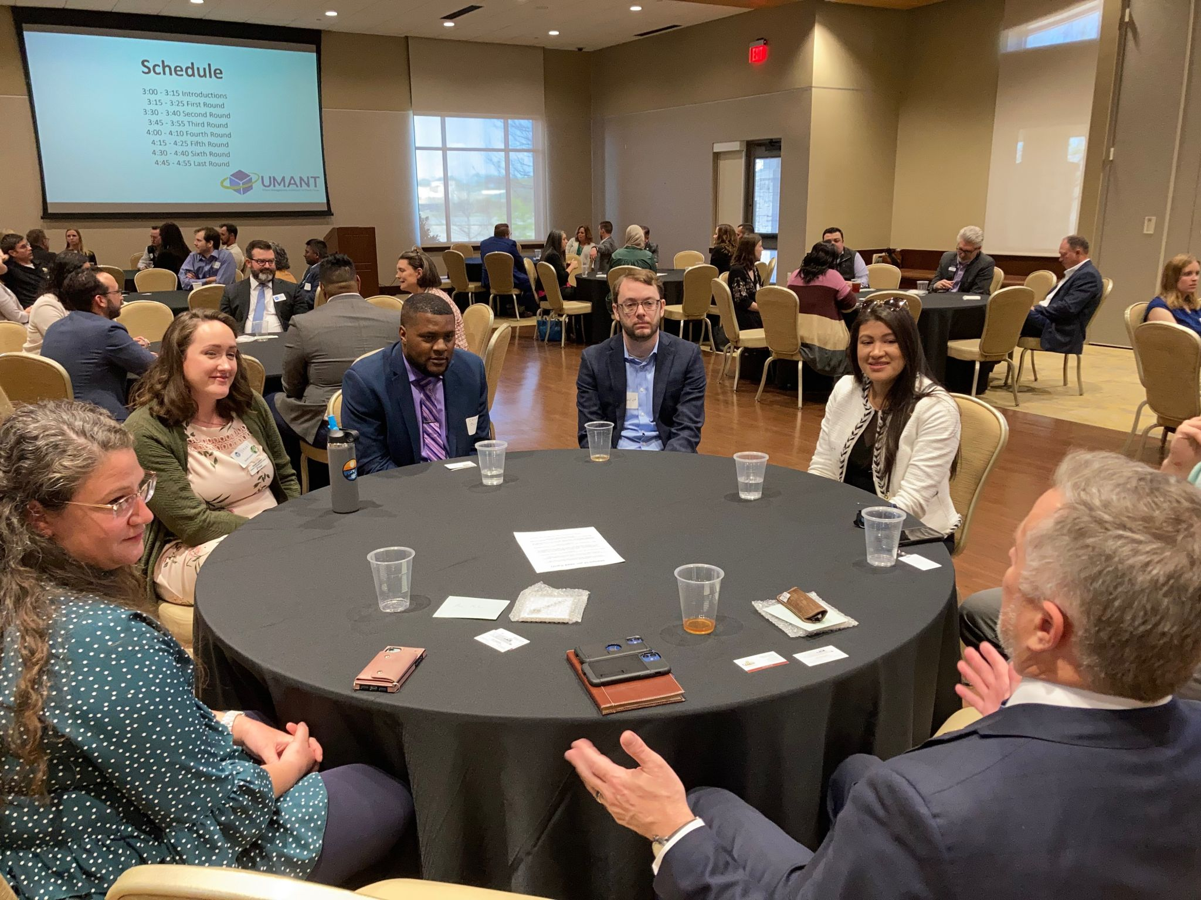
2022 Year in Review
Increase in LinkedIn Reach
38.1% Increase in Page Views
30.4% Unique Visitors
239 new followers
$4,000 Raised at Wine & Dine
69 Tickets Sold
4 Professional Development Events
Increased Event Collaboration
6 of Scholarships Awarded
$4,250 amount awarded
Membership for the year increase by 11

Slide 5

2022
What went well?
What could be improved?

Slide 6
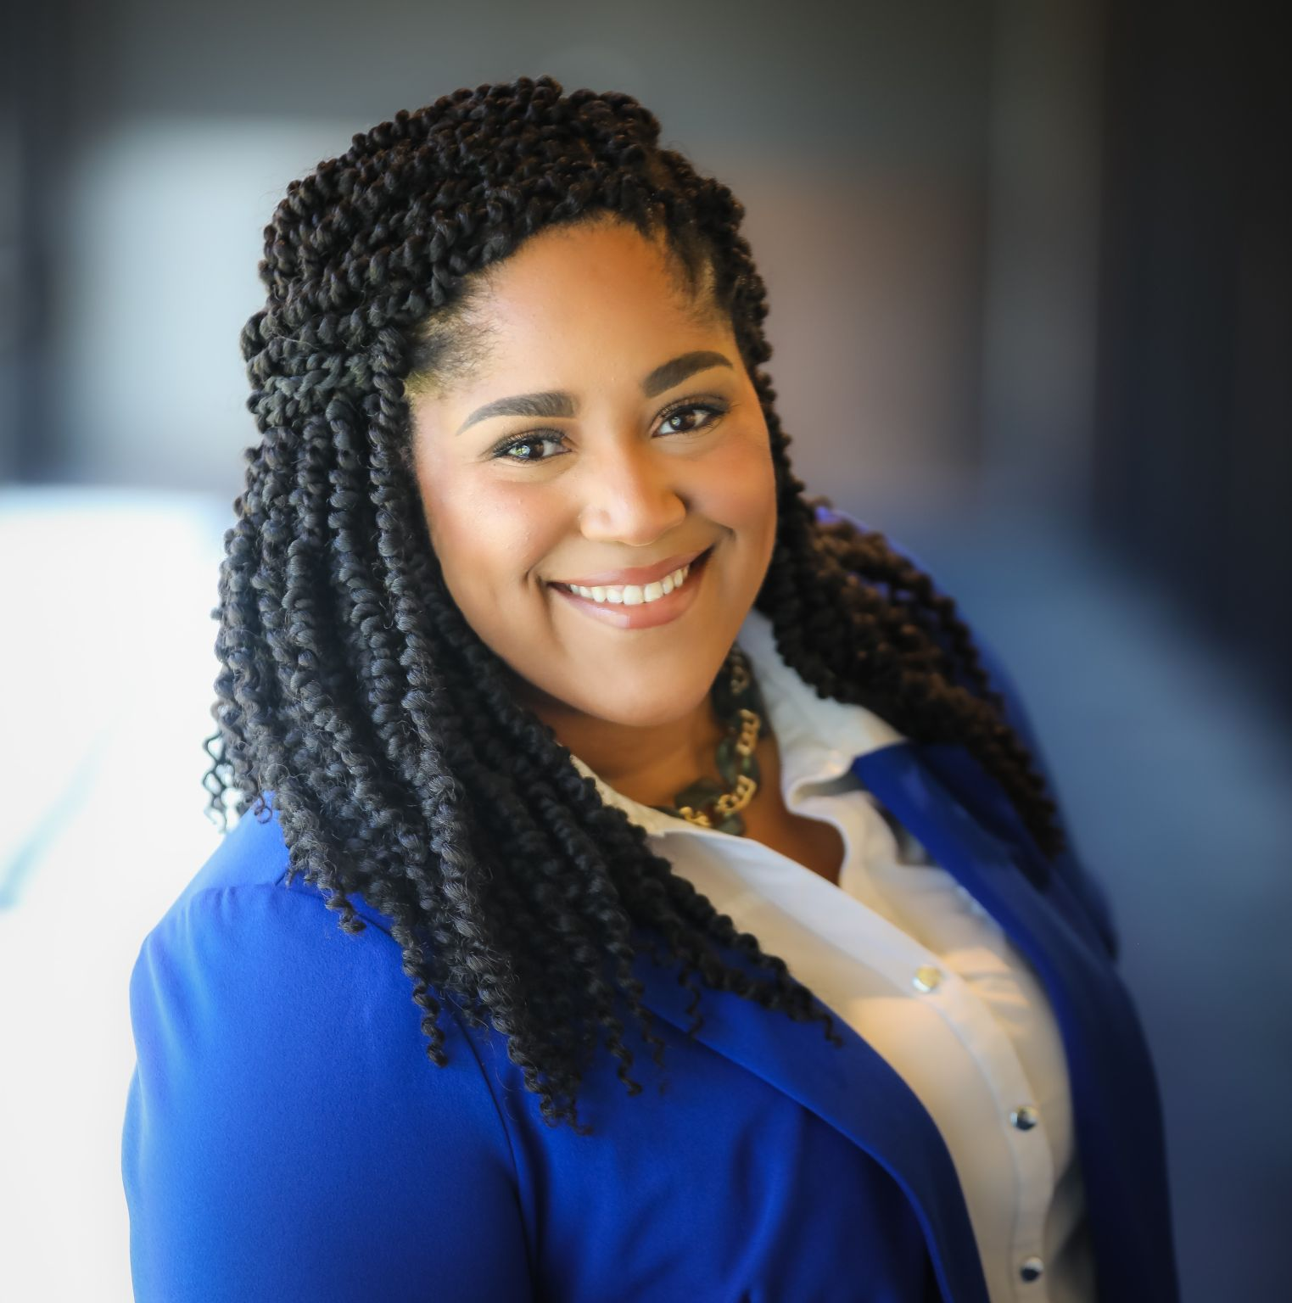
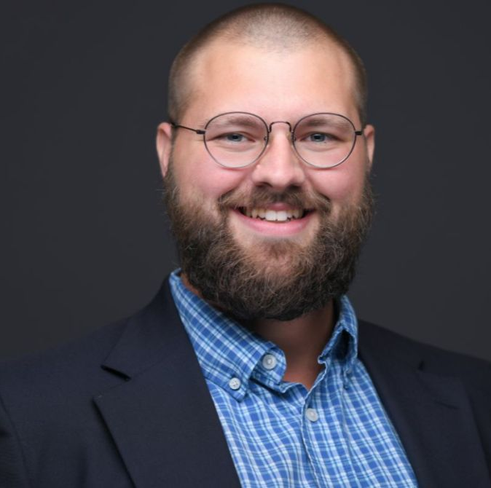

2023 Executive Committee
President
Vice-President
Treasurer
Secretary
Imelda Speck
Brett Cast
Lauren Williams
Jared Devries

Slide 7
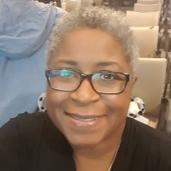
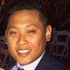
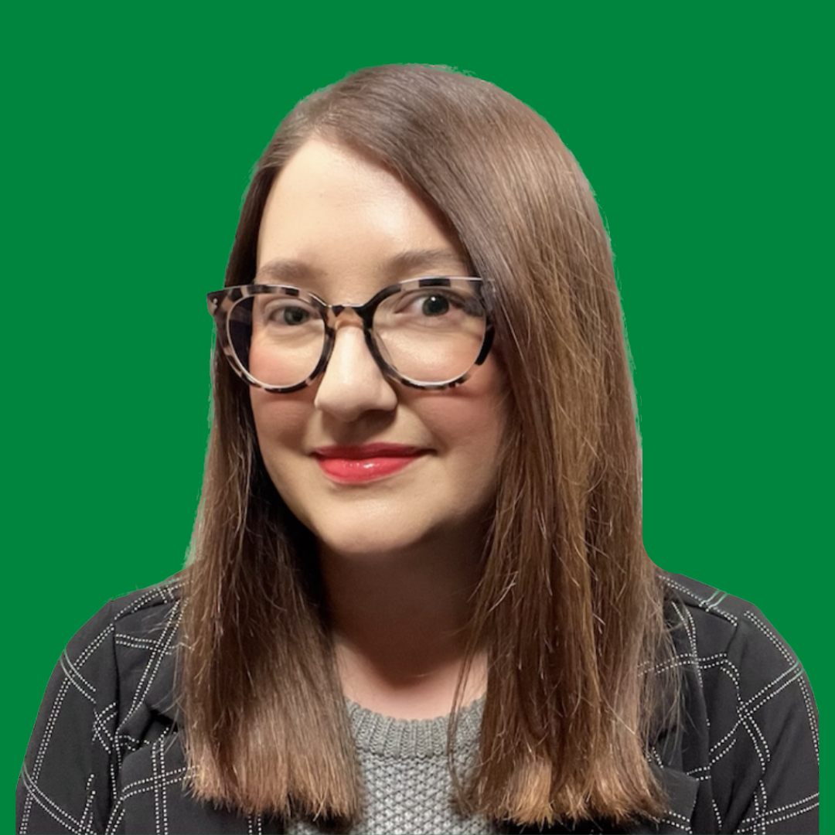
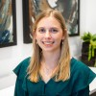
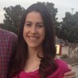
2023 Committees
Communications
Networking & Mentorship
Special Events
Chair:
Maya Williams
Co-Chairs
Tony Cao
Tesla Harlan
Membership & Partnership
Chair:
Brittney Huff
Professional Development
Chair:
Emma Crotty
Chair:
Elizabeth Johnson

Slide 8

Mission
UMANT seeks to advance the quality of local government by providing a community to develop and support emerging leaders.

Slide 9

Idea Sharing
  Potential Professional development topics
  Mentorship opportunities
  Thoughts on how to help increase membership numbers OR add value to our members
  Locations for networking in the DFW area
  Ideas to increase outreach and promotion of the UMANT organization and events
  Ideas for increasing partnership between local universities
  Desire to add another signature event

Slide 10
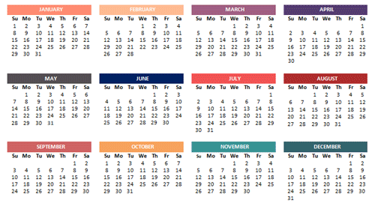
2023 Dates of Note
William “King” Cole Session 1
  Jan. 26-27
William “King” Cole Session 2
  Mar. 30-31
GFOAT Spring Conference
  April 17-19
TCMA Conference (Allen)
  June 8-11
ICMA Conference (Austin)
  Sept. 30 – Oct. 4
TML Annual Conference (Dallas)
  Oct. 4-6
GFOAT Fall Conference
  Oct. 25-27
Texas Downtown
  Oct. 24-27
TML Eco Dev
  Nov. 16-17
Other Dates?

Slide 11
Other Items
General Monthly Meetings
Formalize & Memorialize Committee Work
Day of the Week & Time
Increase use of Drop Box by ALL Committees
Review of Bylaws
Evaluate for any inconsistencies, changes needed
Financial Policies
Formalize financial processes and procedures

Slide 12
Everything we’ll accomplish, we do it together or not at all.
-Shelly Crane

Slide 13
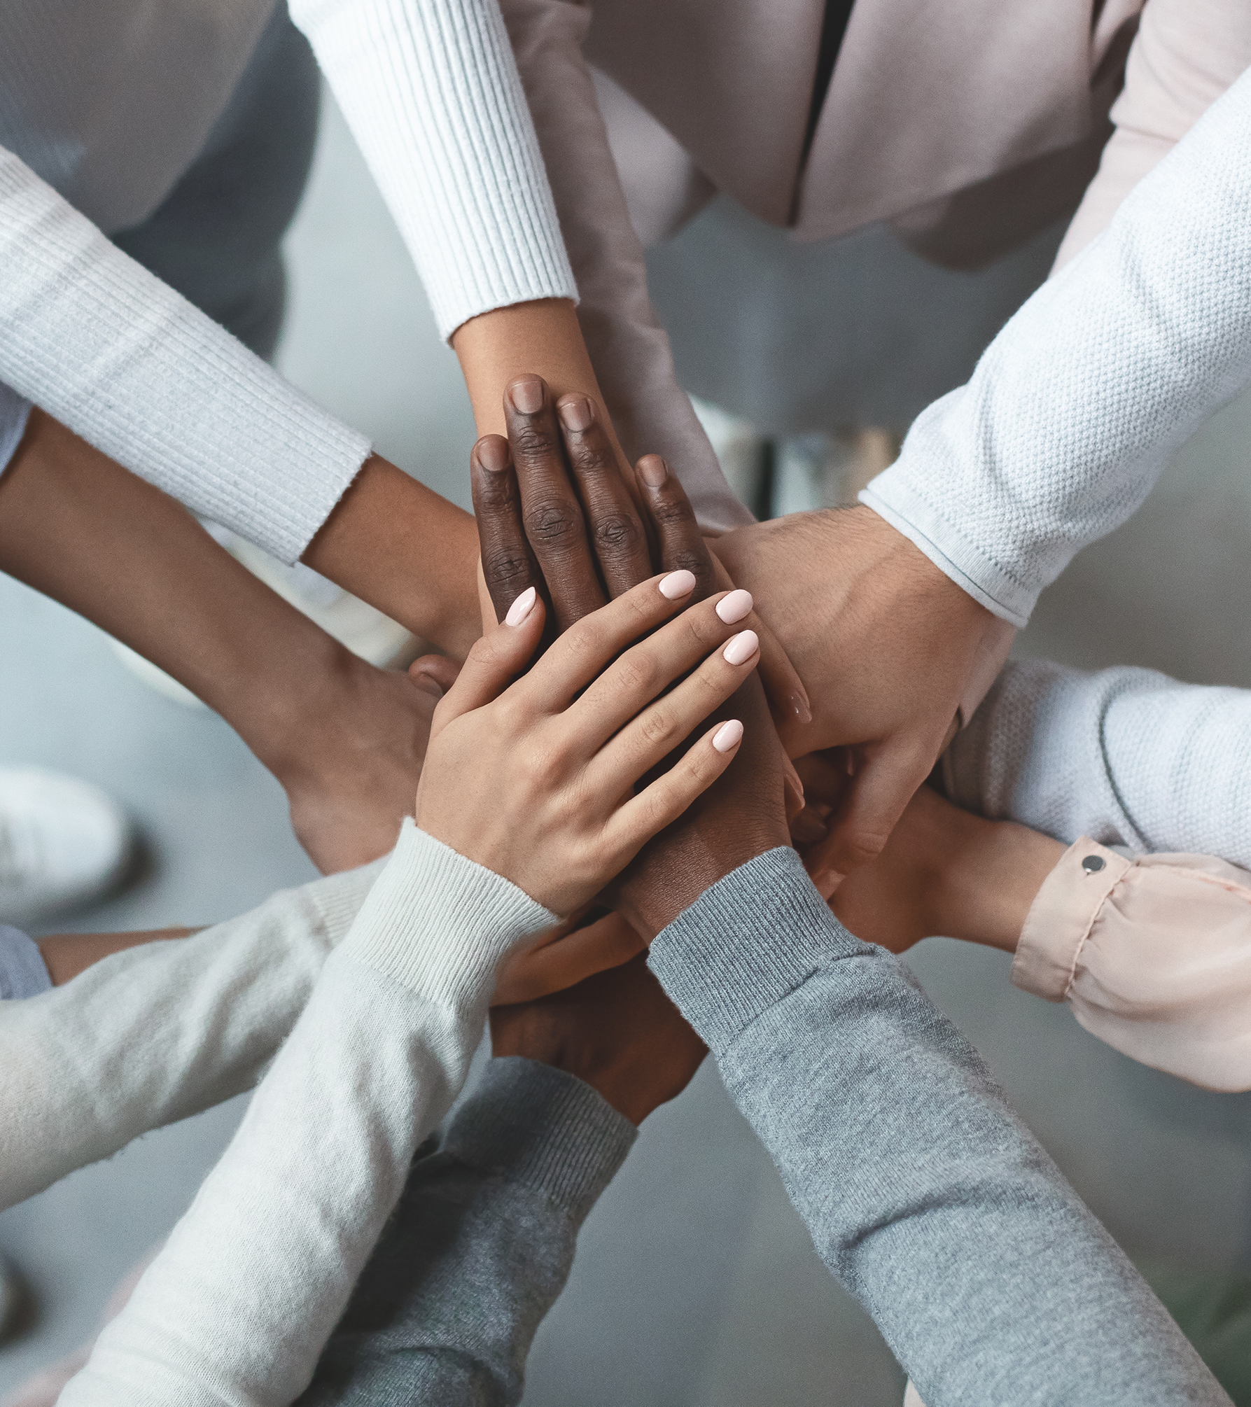
Thank you!

